Slide 1

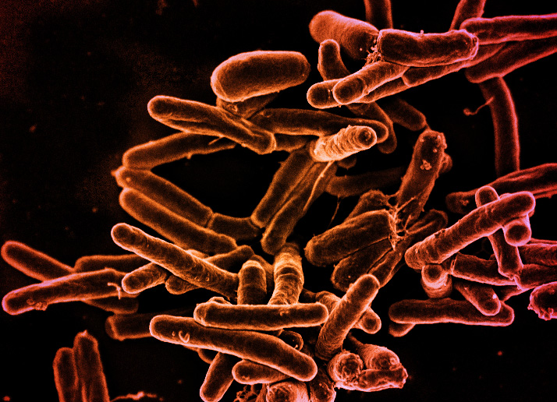
Taking our data from the laboratory to science-based questions
Brooke Anderson, PhD
Associate Professor, Department of Environmental & Radiological Health Sciences, Colorado State University
Image source: NIAID

Slide 2









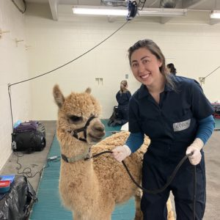

Immune Mechanisms of Protection Against TB Centers
Phoenix IMPAc-TB
CSU Team
Mouse study Lead
Guinea pig study Lead
Immunology Lead
Pathology Lead
Brooke Anderson PhD. Associate Professor
Carolina Mehaffy, PhD.
Assistant Professor
Mike Lyons PhD. Associate Professor
Faye Lanni, PhD.
Research Scientist
Taru Dutt PhD.
Research Scientist
Pablo Maldonado
Doctoral Student
Amanda Hitpas
Lab Manager
Sarah Cooper
Doctoral Student
David (Forrest) Ackart, MS
Senior RA
Tori Mitcham
Research Associate
Alyssa Nelson
DVM Student
Lea Maristela
Undergrad Student

Slide 3
Pipeline for Data Recording and Management
Data recorded by assay in standardized templates
Data pre-processed by assay using standardized, coded protocols
Data converted to database format and stored by domain, not assay
Data in database available to analyze across assays and experiments
Data from different assays handled separately

Slide 4
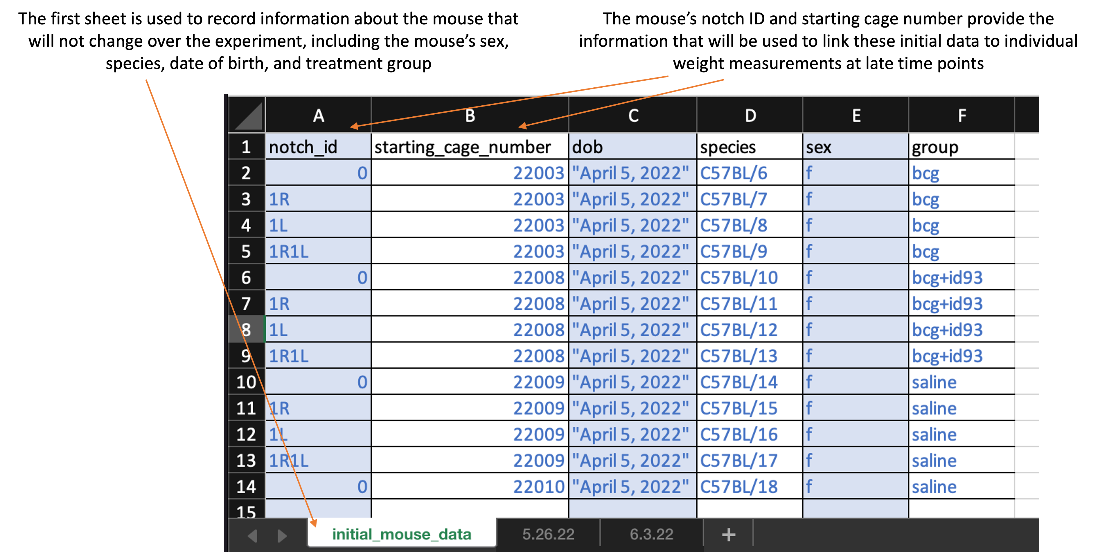
Data Collection Templates Were Standardized and Simplified
Data collection templates allow us to separate data collection from data processing and analysis
Rapid report generation helps to monitor experiments
Well-documented code scripts standardize the pre-processing of data from each assay / readout

Slide 5
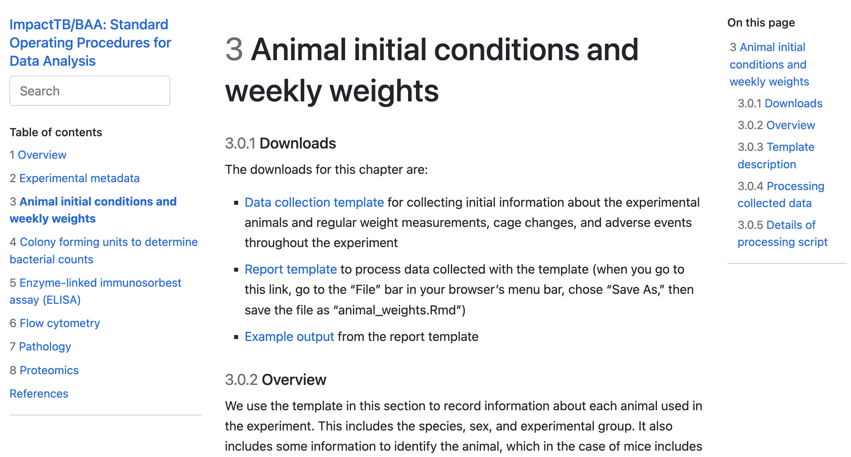
Templates Are Documented and Shared through Online Book
https://csu-impactb.github.io/CODING-TEAM-BOOKDOWN-/animal-initial-conditions-and-weekly-weights.html

Slide 6
Pipeline for Data Recording and Management
Data recorded by assay in standardized templates
Data pre-processed by assay using standardized, coded protocols
Data converted to database format and stored by domain, not assay
Data in database available to analyze across assays and experiments
Data from different assays integrated

Slide 7
A Standardized Data Format is Used for Database: CDISC/SDTM/SEND
Final Laboratory Data
Assay-Specific Templates
(tidy data format)
Assay
1
Assay
2
Assay
3
…
Assay
n
Experiments and Measurements
Organized into Domains
- Logically related observations
Examples: Demographics
Cell Phenotype
Microscopic Findings
Vital Signs
Microbiology Findings
Laboratory Data
Domain
A
Domain
B
Domain
C
Relational Database
Clinical Data Interchange Standards Consortium (CDISC)
https://www.cdisc.org/
Study Data Tabulation Model (SDTM)
Standard for Exchange of Nonclinical Data (SEND)

Slide 8
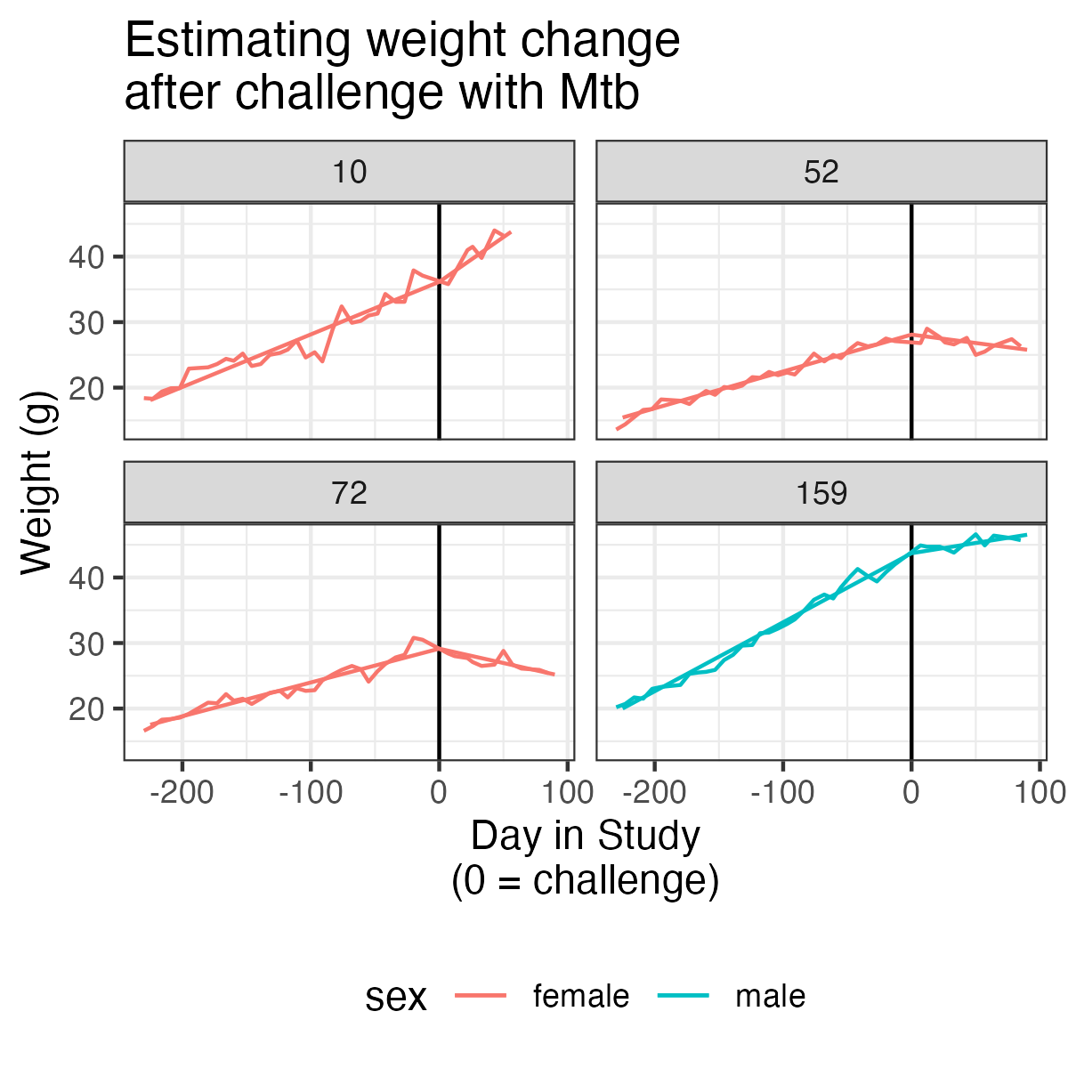
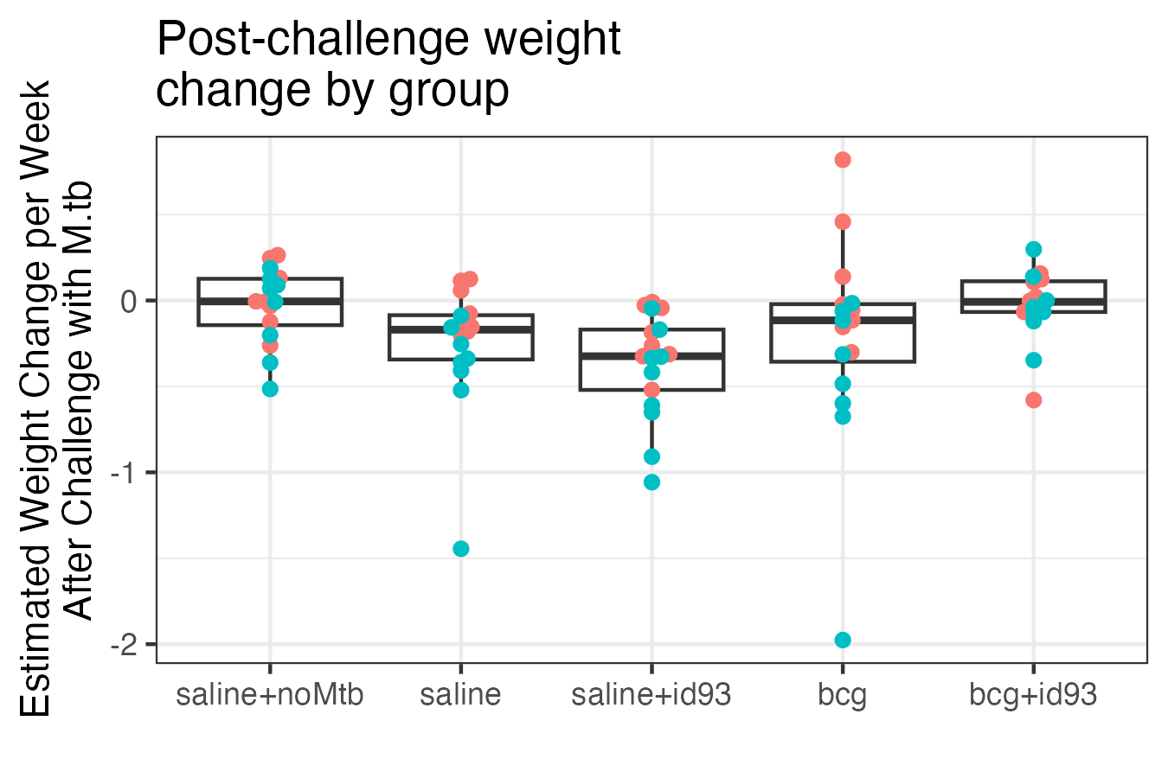
Investigating Patterns in Weight Loss after M.tb Challenge
For each mouse, we estimated the rate of weight change after challenging with M.tb, using a Bayesian model to stabilize estimates.
We investigated these weight changes by group. There were patterns that were consistent with other experimental results. On average, the largest rates of weight loss were in the groups of Saline and Saline+ID93.

Slide 9
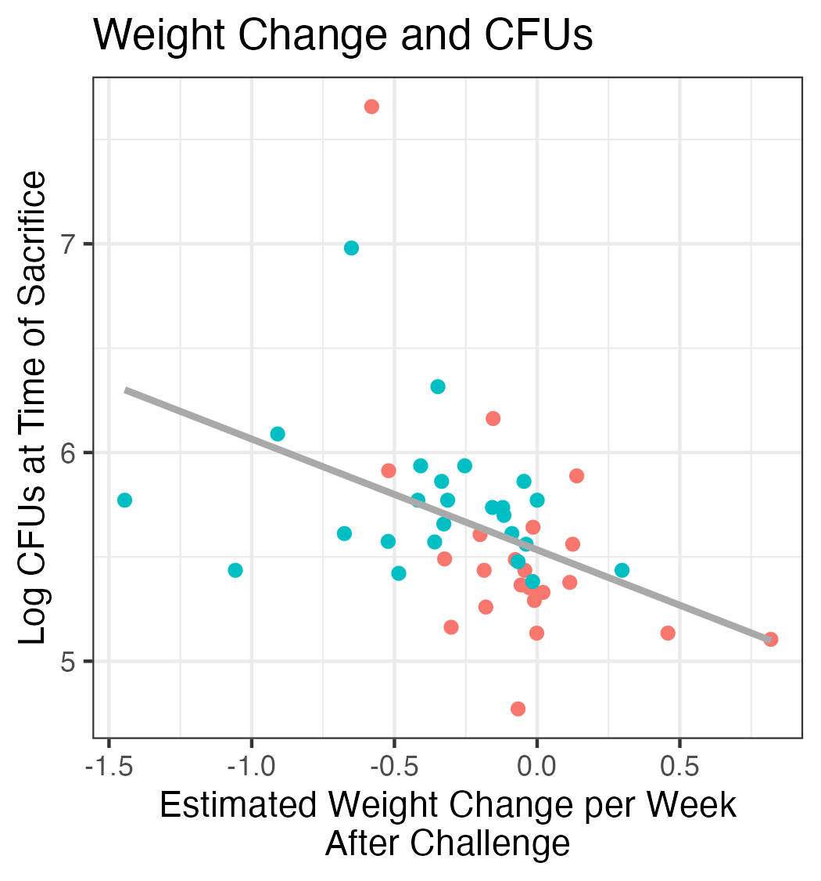
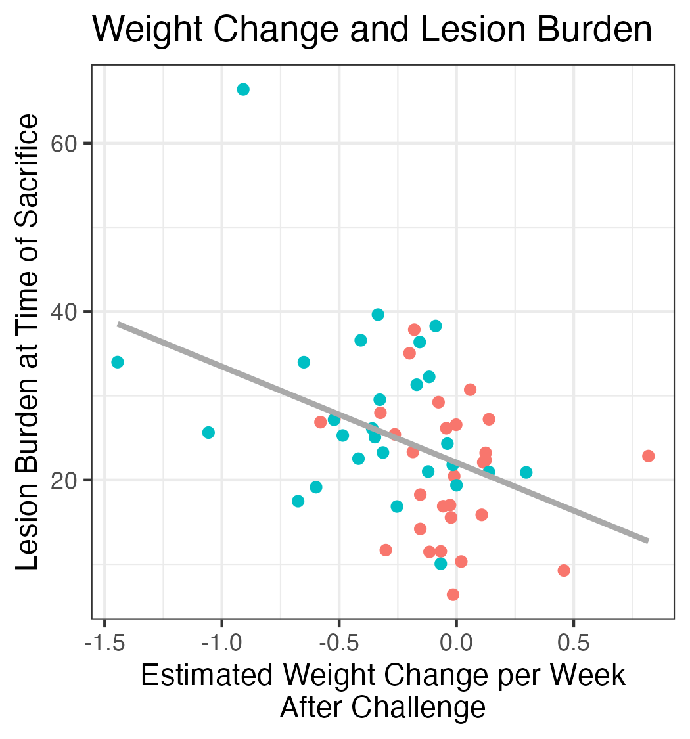
Investigating Associations between Weight Loss and Other Outcomes
We investigated how each mouse’s post-challenge weight change was associated with its final measures of bacterial burden (CFUs) and lesion burden.

Slide 10
Combining Dynamics of Bacillary Burden & Pathology
Quantitative Ranking of Vaccine Effect
CFU
“+”
LESION AREA

